Slide 1
Yojna Connect
A Multilingual Government Services Assistant Chatbot
Garv Sharma (2K22CSUN01138)
Aryan Bhanot (2K22CSUN01130)
Vibhay Bakshi (2K22CSUN01157)

Slide 2
Table of contents
01
02
03
04
05
06
07
Introduction
Objectives
SDG Goals
Gaps identified
Dataset
Methodology
App Interface

Slide 3
01
Introduction

Slide 4
Introduction
Problem
Solution
The government provides various schemes and policies, but citizens often struggle to find accurate, easy-to-understand information in their preferred language. This creates a gap in awareness and access.
Our chatbot leverages Natural Language Processing (NLP) and API to deliver government policy details in multiple languages, ensuring better accessibility, enhanced citizen engagement, and simplified policy explanations.

Slide 5
02
Objectives

Slide 6
Objectives
Simplify Policies
Convert complex policies into simple, understandable answers.
Accurate Info
Ensure citizens get up-to-date, reliable scheme details.
Boost Engagement
Encourage citizen interaction through instant, transparent replies.
Multilingual Support
Deliver information in Hindi, English & regional languages.
Save Time
Seamless Access
Minimize the need for manual inquiries and long processes.
Make benefits & services directly accessible.
Personalise output
Make sure to tone the response based on the user’s intent.

Slide 7
03
SDG Goals

Slide 8


SDG GOALS
Our chatbot enhances transparency and accessibility of government schemes, empowering citizens with accurate information in multiple languages. This promotes strong institutions and citizen participation in governance.
By leveraging AI, NLP, and multilingual support, our chatbot improves digital public infrastructure, ensuring equitable access to government resources, especially for marginalized communities.

Slide 9
04
Gaps identified

Slide 10
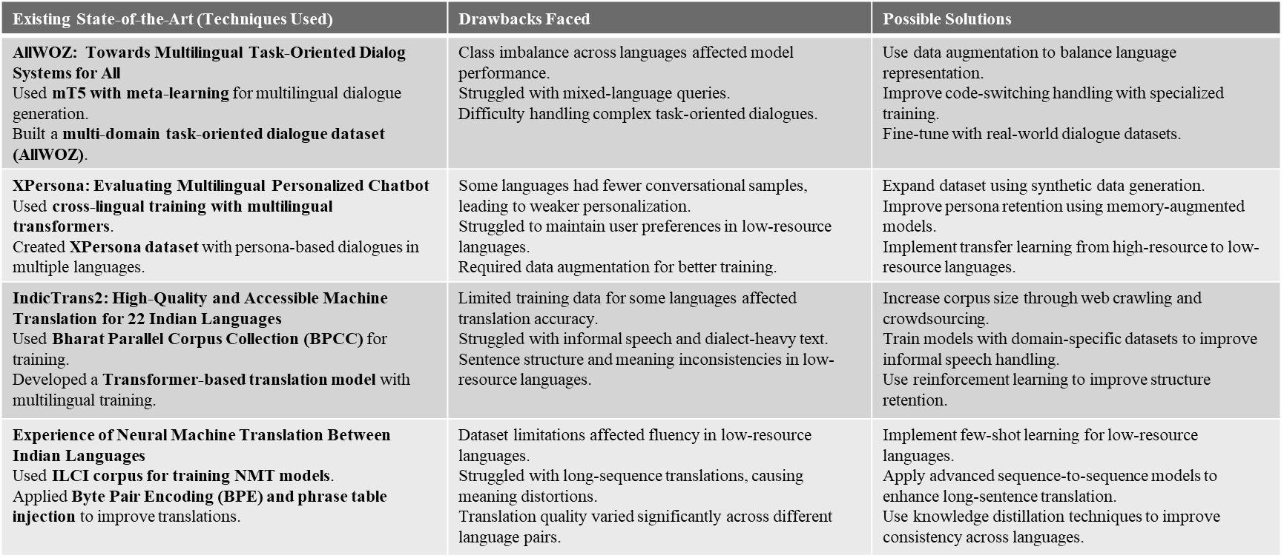
Gaps identified

Slide 11
05
Dataset

Slide 12
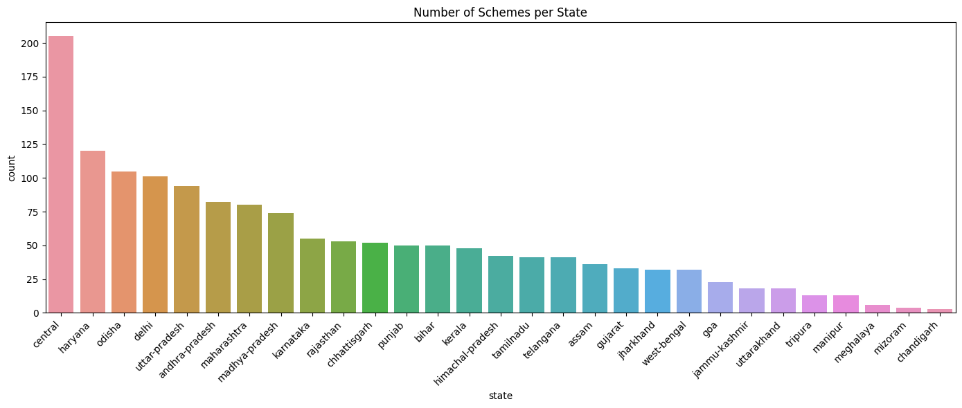
Dataset
Indian Government Schemes Dataset
Overview: A dataset available on Kaggle that compiles descriptions of various schemes introduced by the Indian government. Link: https://www.kaggle.com/datasets/nitishabharathi/indian-government-schemes
Coverage:
29 folders: 28 states + 1 central government
Total: 1,444 unique schemes
Format: “.txt” files with structured information:
Scheme name, description, ministry, beneficiaries, eligibility, sector
Figure 1. Bar graph on the number of schemes for each state

Slide 13
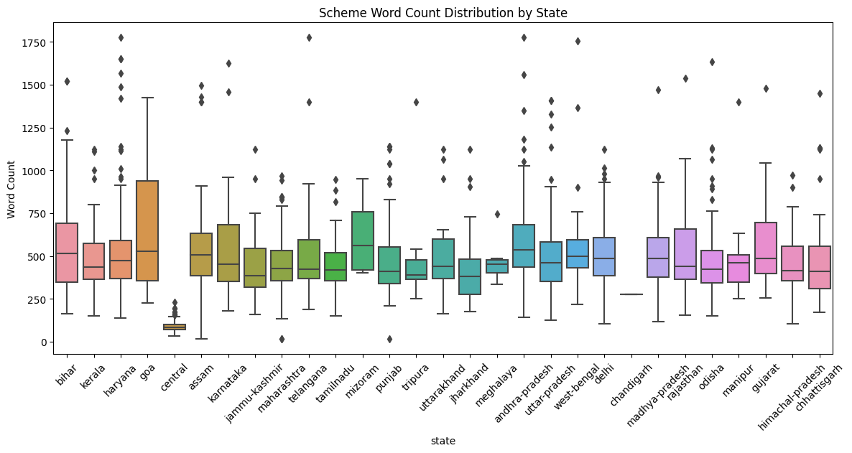
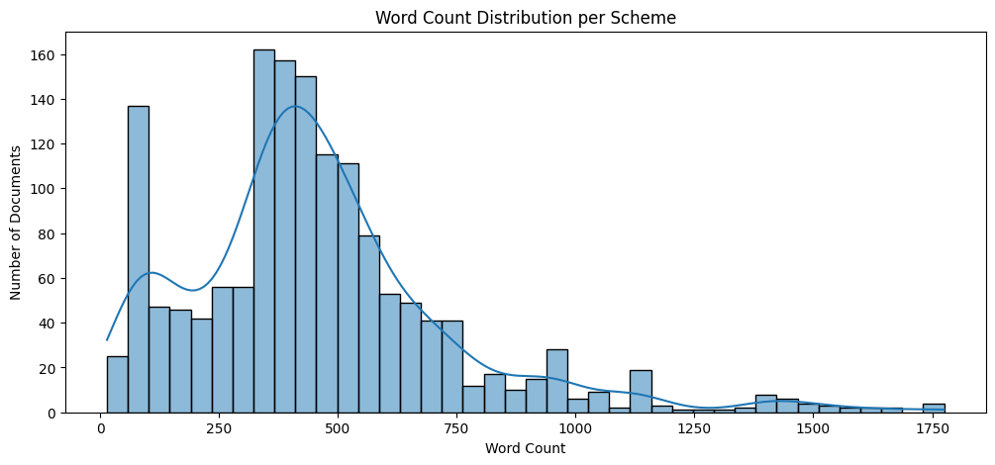
Data Visualisations
Figure 2. Boxplot on the number of words for each state’s schemes
Figure 3. Histogram on the number of words for each scheme

Slide 14
06
Methodology

Slide 15
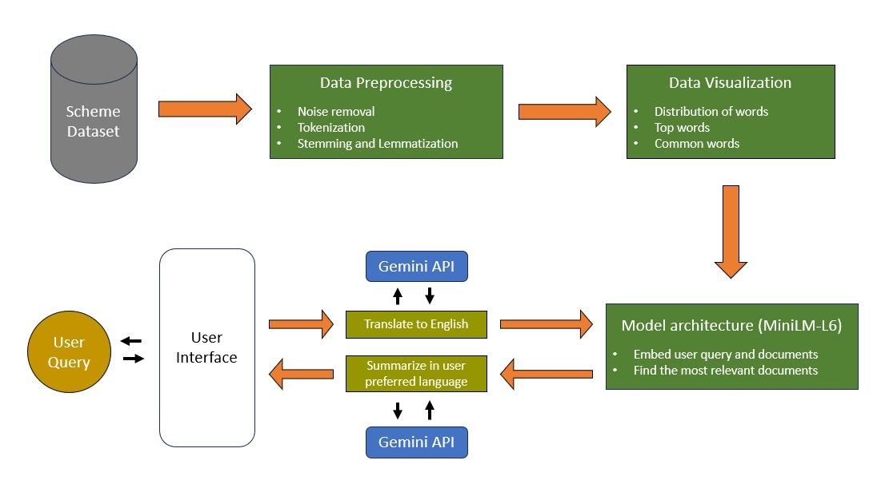
WORKING OF THE CHATBOT
Figure 4. A sequenced diagram depicting the flow of our chatbot

Slide 16
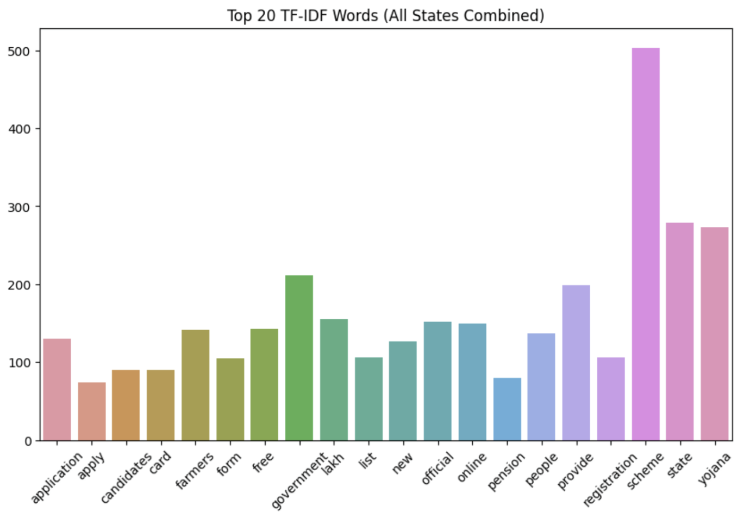
Dataset preprocessing
1. Text Preprocessing Steps
Lowercasing & Noise Removal: Removed boilerplate text, non-alphabetic characters, and extra spaces.
Language Filtering: Retained only Roman script to avoid noisy multilingual mix.
Tokenization: Split text into individual word tokens.
Stopword Removal: Eliminated frequent, non-informative words.
Stemming & Lemmatization: Normalized tokens to meaningful base forms using Porter and a neural lemmatizer.
2. Feature Extraction Techniques
TF-IDF Vectors: Highlighted important terms per document.
Bigrams: Extracted frequent two-word phrases for capturing phrase context.
Word2Vec Embeddings: Generated 100-dimensional vectors to capture word semantics
Figure 5. Bar graph on the top 20 TF-IDF words

Slide 17
Model Architecture
1. Semantic Retrieval
Model: all-MiniLM-L6-v2 (SentenceTransformer)
Process:
Translate user query to English (if needed)
Generate 384-d embeddings for both query and documents
Use cosine similarity to retrieve the top-N most relevant schemes
2. Summarization
Tool: Google Gemini 2.5 API
Method:
Concatenate top-N retrieved texts
Use abstractive summarization to generate personalized responses
3. Translation
Translated output summary back into the user’s preferred language
Ensures full multilingual support and accessibility
4. End-to-End Flow
Input → Translation → Embedding → Retrieval → Summarization → Translation (back)
Average response time: < 5 seconds

Slide 18
07
App Interface

Slide 19
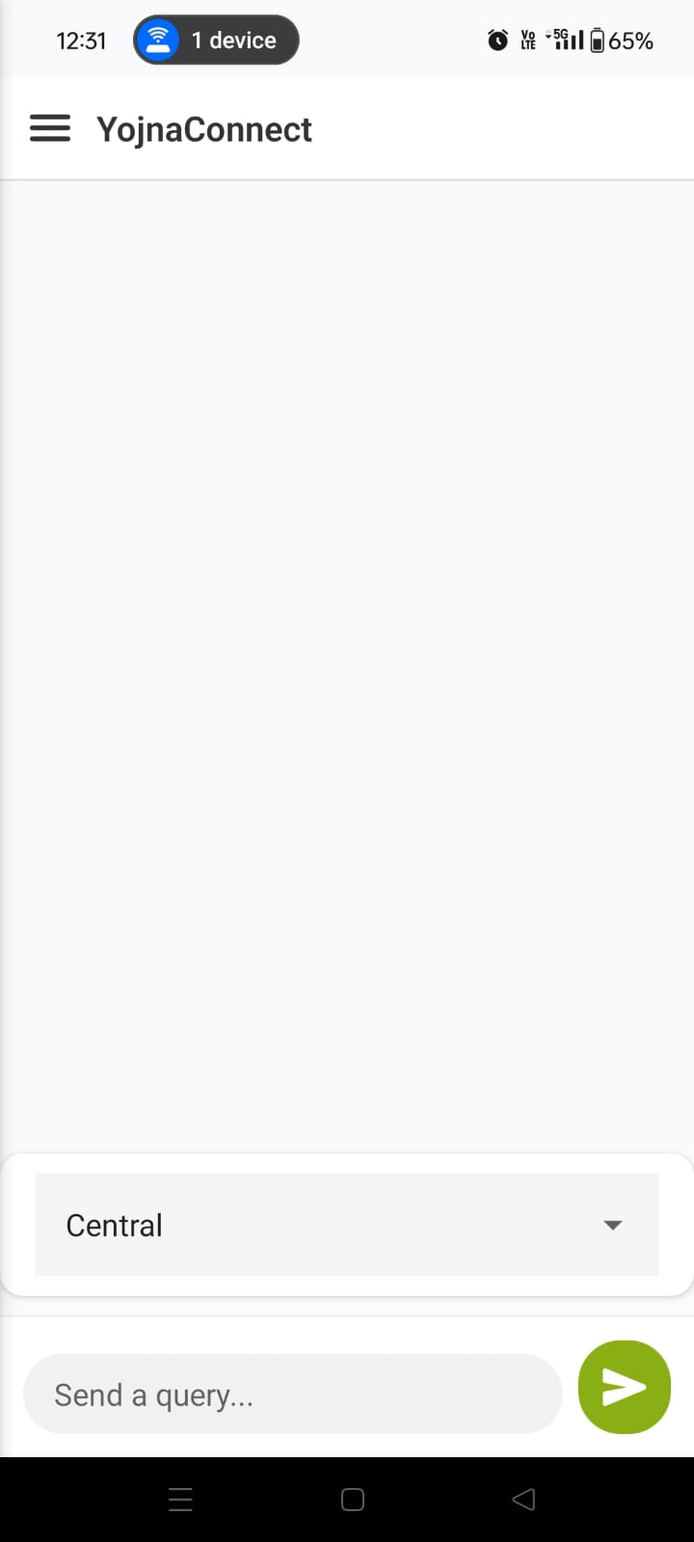
App Architecture
Frontend
React Native + Expo SDK for the cross-platform mobile experience
Axios handles API communication with the backend server
UI includes:
Text input for natural language queries
State selection dropdown
Chat history view
Backend
Flask server with /search endpoint
Loads:
Processed dataset
MiniLM SentenceTransformer model
Handles:
Translation (if non-English input)
Embedding generation & similarity search
Summarization using Gemini 2.5 API
Hosted locally, ready for Heroku/AWS deployment
Figure 6. Chatbot Interface

Slide 20
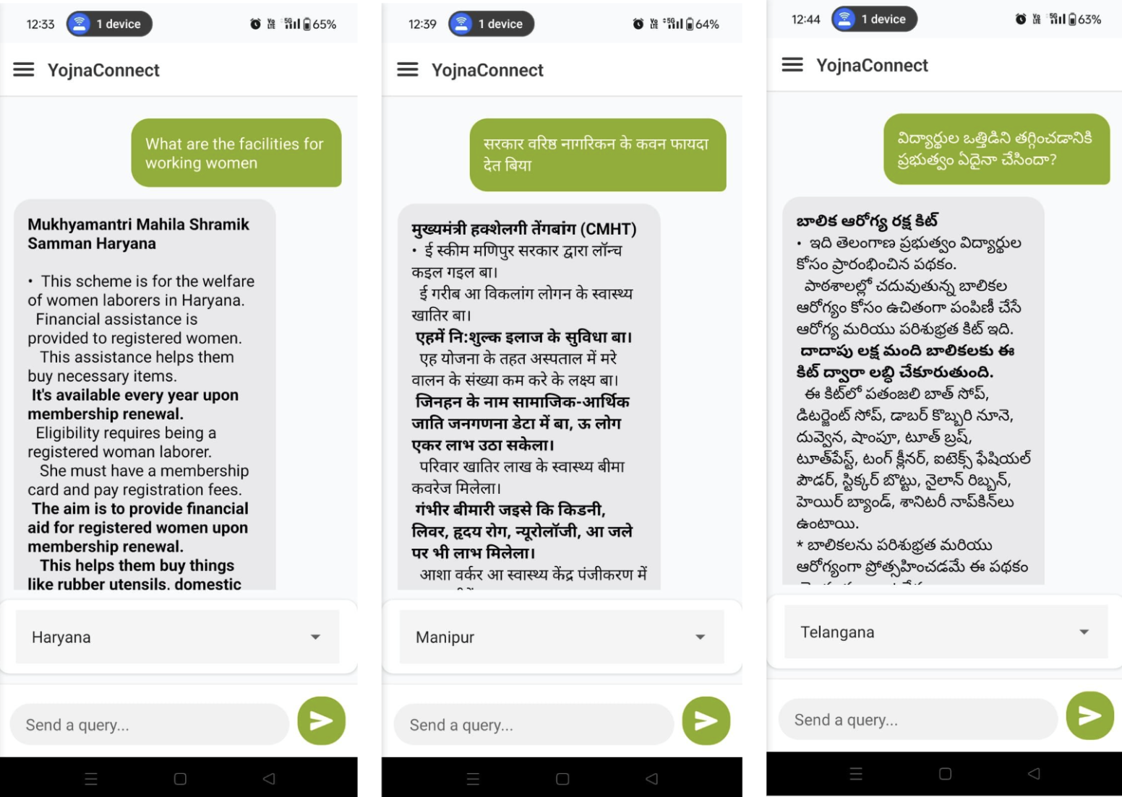
How to Use the App
Enter your question – E.g., "What are the education schemes in Gujarat?"
Choose your state – Dropdown list of 28 states + Central
Submit your query – Frontend sends it to the backend for processing
Receive summarized schemes – AI returns easy-to-understand results in your selected language
View previous queries – Scrollable chat history (Fig. 7 shows English, Bhojpuri, Telugu queries)
Figure 7. Queries in 3 different languages: English, Bhojpuri and Telugu

